Slide 1
COMP 4290
Week 9 - Friday

Slide 2
Last time
Network basics
Network threats

Slide 3
Questions?

Slide 4
Project 2

Slide 5
Austin Rheyne Presents

Slide 6
Reconnaissance

Slide 7
Reconnaissance
A smart attacker learns everything he or she can about the system before attacking it
Useful methods for reconnaissance of a network include:
Port scans
Social engineering
Dumpster diving
OS and application fingerprinting
Background research

Slide 8
Port scan
Many targeted systems include servers that are always listening on various ports, waiting for communication
A port scanner is a program that tries to connect on many interesting ports to see what kinds of communication is ready to do
If a server is poorly configured, it might be listening on ports even the administrators don't know about
Common free port scanners:
nmap
netcat

Slide 9
Social engineering
Social engineering means techniques used to get a human being to unknowingly divulge information to an outsider
Often this is done by posing as tech support or some kind of contractor
Attackers can pretend to be someone from another department
Most employees have been trained to be reluctant to give up their passwords
However, they will often reveal their IP address, OS information, and other useful pieces of system information

Slide 10
Gathering more intelligence
Port scans and social engineering can tell a lot
Dumpster diving or going through trash can tell a lot as well
Which pieces of hardware have been bought, by their packaging
Phone lists or organization charts could be in the trash
Diagrams, notes, even passwords could be written on scraps of paper
Old hard drives with sensitive information could turn up
For high-level attacks, real spying is possible

Slide 11
OS and application fingerprinting
Port scanning gives a lot of information
For example, port 443 is used for HTTPS
But you may want to know which OS or application is actually listening at a port
Vulnerabilities are often system-dependent
Some applications will reveal themselves directly
Others will give more information if you ask for a feature that is unavailable or give a bad command
You are being fingerprinted when you visit websites
Your browser identifies which browser it is
You can hide this information, but your web pages might look weird

Slide 12
Documentation and hacking tips
How do you actually do the attack?
Same as everything else:
Google
Once you know the system you are attacking, you can search the Internet and security blogs and boards for vulnerabilities
Because networking is often between different kinds of systems running different kinds of software, features are well-documented
Most big viruses and worms use publicly known vulnerabilities that haven't been patched

Slide 13
Eavesdropping

Slide 14
Eavesdropping and wiretapping
Eavesdropping means overhearing private information without much effort
Administrators periodically need to monitor network traffic
Wiretapping implies that more effort is being used to overhear information
Passive wiretapping is only listening to information
Active wiretapping means that you may adding or changing information in the stream

Slide 15
Cable wiretapping
If you are on the same LAN, you can use a packet sniffer to analyze packets
Packets are constantly streaming by, and your computer usually only picks up those destined for it
Passwords are often sent in the clear
Wireshark is a free, popular packet sniffer
Cable modems are filters that give you only the data you need
Sophisticated attackers can tap into a cable network
Data is supposed to be encrypted, but many networks don't turn encryption on
Inductance is a property that can allow you to measure the signals inside of a wire without a direct physical connection
Using inductance or physically connecting to a wire changes its impedance, which can be (but usually is not) measured
Signals are often multiplexed, sharing media with other signals, which can increase the sophistication needed to wiretap

Slide 16
Wireless eavesdropping
Wireless networks are easy to disrupt, but attackers usually have little to gain by this
Since they are broadcast, it is not difficult to intercept the signal
Special antennas can receive the signal from a longer distance than usual
Some networks are entirely unencrypted
WEP is almost completely broken
WPA and WPA2 have vulnerabilities that can be exploited in some cases

Slide 17
Other media
Microwave is easy to intercept
Long distance phone can use microwaves
Cell phones towers can use microwaves
One difficulty with making use of the intercepted signal is that microwave signals are heavily multiplexed, making it hard to untangle individual signals
Satellites are similar (unsecure but heavily multiplexed)
Optical fiber is very difficult to tap
Cutting a single fiber means recalibrating the network
Repeaters and taps that connect the fiber are the best places to attack

Slide 18
Impersonation
Rather than wiretapping, attackers will more often try to impersonate a legitimate user
Different approaches:
Guess the identity and authentication information
Use other communications or wiretapping to gain such information
Circumvent the authentication mechanism
Use a target that will not be authenticated
Use a target with known authentication data

Slide 19
Authentication issues
Passwords are often easy to guess
Because we're bad at picking passwords
Because the user may not have realized that the machine would be exposed to network attacks
Passwords are sent in the clear
Bad hashes can give information about the password
Sometimes buffer overflows can crash the authentication system
Sometimes authentication is not needed
.rhosts and .rlogin files in Unix
Guest accounts
Default passwords on routers and other devices that never get changed

Slide 20
Authentication attacks
Spoofing is when an attacker carries out one end of a networked exchange
A masquerade is spoofing where a host pretends to be another host
URL confusion: someone types hotmale.com (don't go there!) or gogle.com
Phishing is a form of masquerading
Session hijacking (or sidejacking) is carrying on a session started by someone else
Login is encrypted, the rest of the data isn't always (though it increasingly is, through HTTPS)
Firesheep was a browser plugin that allowed you to log on to other people's Facebook and Twitter accounts in, say, the same coffeeshop (but it no longer works)
Man-in-the-middle attacks

Slide 21
Confidentiality threats
Misdelivery
Data can have bad addresses, occasionally because of computer error
Human error (e.g. James Hughes (student) instead of James Hughes (professor)) is more common)
Exposure of data can happen because of wiretapping or unsecure systems anywhere along the network
Traffic flow analysis
Data might be encrypted
Even so, it is very hard to hide where the data is going to and where it is coming from
Tor and other anonymization networks try to fix this

Slide 22
Integrity threats
Attackers can falsify some or all of a message, using attacks we've talked about
Parts of messages can be combined
Messages can be redirected or deleted
Old messages can also be replayed
Noise can degrade the signals
All modern network protocols have error correction built in
Malformed packets can crash systems
Protocols often have vulnerabilities

Slide 23
Wireless Network Security

Slide 24
WiFi technology
WiFi signals are radio signals that anyone in range can pick up
WiFi is built on a set of protocols defined by the 802.11 standards
Most of these protocols communicate in the 2.4 and 5 GHz ranges
Older protocols can reach about 300 feet and 802.11n may be able to reach 5,000 feet
A wireless access point communicates with a network interface card (NIC)
MAC addresses are used to identify physical devices

Slide 25
Mechanics
Management frames are data exchanged by access points and routers to structure communication
Beacon frames announce the presence of an access point
Authentication frames allow NICs to request access to an access point
Association frames allow NICs and access points to agree on how to communicate
The Service Set Identifier (SSID) is a string that identifies an access point

Slide 26
WiFi vulnerabilities
SSIDs do not need to be broadcast
However, when someone joins the access point, the SSID is revealed
Access points associate a computer with a MAC address
But MAC addresses can be spoofed!

Slide 27
WEP
The original system for encrypting wireless communication was Wired Equivalent Privacy (WEP)
WEP is not secure!
WEP keys are effectively either 40 bits (breakable!) or 104 bits
Static keys are used
A flaw in the RC4 algorithm allows even 104-bit keys to be broken in minutes
WEP does no authentication

Slide 28
WPA
WiFi Protected Access (WPA, WPA2, and WPA3) was created to replace WEP
WPA uses a different key to encrypt each packet
Authentication for WPA is better (although still uses a shared secret for home use)
WPA has a better integrity check than WEP
WPA2 adds AES for encryption, much stronger than RC4
WPA3 was supposed to make it harder to collect information and brute force the key
Although each version improves on earlier weaknesses, there are attacks on WPA, WPA2, and WPA3 that can make it possible to intercept wireless traffic

Slide 29
Weaknesses of WPA
Man-in-the-middle attack is still possible
The attacker convinces the access point that he's the user and convinces the user that he's the access point
Requires spoofing MAC addresses
Brute force attacks
WPA allows users to select passphrases
Users often select poor passphrases
Some practical attacks against integrity exist in WPA (but not WPA2)

Slide 30
Denial of Service

Slide 31
Denial of service
Networks are one of the best places to launch an attack on availability
In this setting, these are usually called denial of service (DoS) attacks
DoS attacks are very hard to avoid

Slide 32
Ways to make DoS happen
Flooding overloads capacity
Ask for too many connections
Request too many of some other service
Blocking access
Crash an application
Interfere with network routing protocols
Access failure
Hardware or software fails

Slide 33
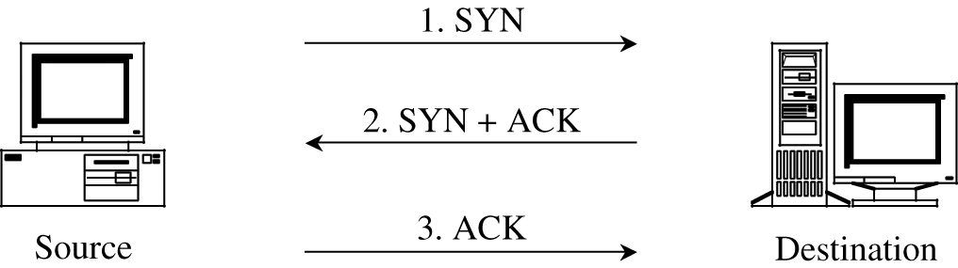
SYN flood
TCP is built on a three-way handshake
Client requests a connection by sending a SYN packet
The server acknowledges the request by sending a SYN-ACK packet back
The client responds with an ACK, establishing the connection
An attacker can just keep sending SYN packets
The server will allocate some resources, wait for the ACK, and never get it
A clever attacker will spoof at least his own IP so that the SYN-ACK is sent elsewhere
A more sophisticated attacker will spoof many different IP addresses (or have many bots in a botnet) sending all these SYN's

Slide 34
Other denial of service attacks
Echo-chargen
Chargen sets up a stream of packets for testing
Echo packets are supposed to be sent back to the sender
If you can trick a server into sending echo packets to itself, it will respond to its own packets forever
Ping of death
A ping packet requests a reply
If you can send more pings than a server can handle, it goes down
Only works if the attacker has more bandwidth than the victim (DDoS helps)
Smurf
A ping packet is broadcast to everyone, with the victim spoofed as the originator
All the hosts try to ping the victim
The real attacker is hidden
Teardrop
A teardrop attack uses badly formed IP datagrams
They claim to correspond to overlapping sequences of bytes in a packet
There's no way to put them back together and the system can crash

Slide 35
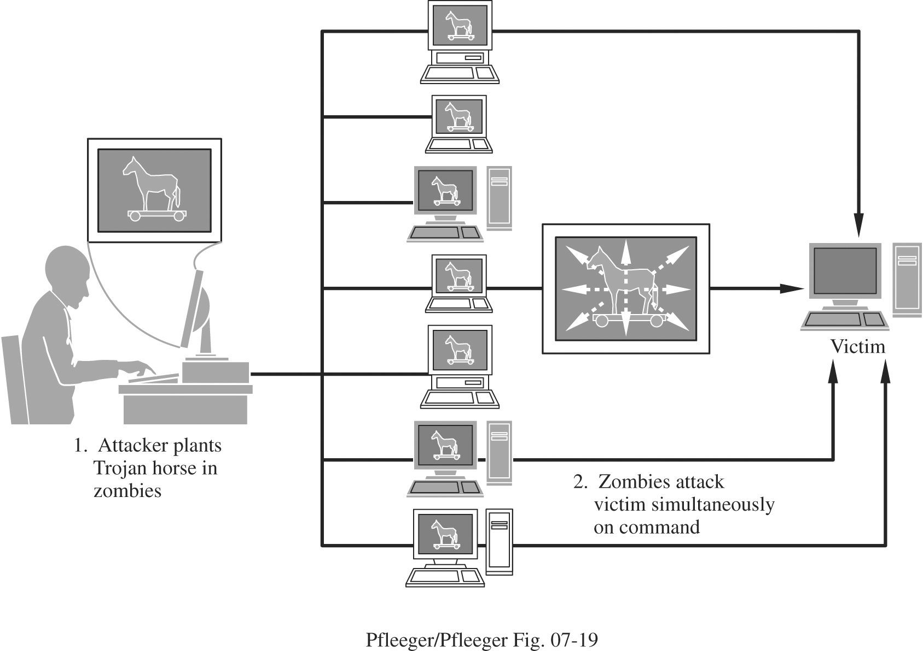
Distributed denial of service
Distributed denial of service (DDoS) attacks use many machines to perform a DoS attack
Usually, many targets have been compromised with a Trojan horse making them zombies or bots
These zombie machines are controlled by the attacker, performing flooding or other attacks on a victim
A network of zombies is called a botnet
The attacker is hard to trace

Slide 36
Stopping DDoS attacks
The best defense is prevention
DDoS attacks are usually mounted by bots that were compromised by known vulnerabilities
Patch your stuff!
Defense against DoS attacks:
Tuning: adjusting the number of active servers
Load balancing: redirecting traffic to servers that aren't getting used
Shunning: reducing service given to certain IP addresses
Blacklisting: ignoring traffic from known bad IP addresses

Slide 37
DNS attacks
The Domain Name System (DNS) uses Domain Name Servers (also DNS) to convert user readable URLs like google.com to IP addresses
Taking control of a server means that you get to say where google.com is
Called DNS spoofing
For efficiency, servers cache results from other servers if they didn't know the IP
DNS cache poisoning is when an attacker gives a good server a bad IP address

Slide 38
Summary of vulnerabilities
Target | Vulnerability | Target | Vulnerability
Precursors to attack | Port scan Social engineering Reconnaissance OS and application fingerprinting | Confidentiality | Protocol flaw Eavesdropping Passive wiretap Misdelivery Exposure Traffic flow analysis
Authentication failures | Impersonation Guessing Eavesdropping Spoofing Session hijacking Man in the middle attack | Integrity | Protocol flaw Active wiretap Impersonation Falsification Noise Web site defacement DNS attack
Programming flaws | Buffer overflow Addressing errors Server-side include Malicious Java or ActiveX Worms, viruses, Trojan horses | Availability | Protocol flaw Transmission failure Flooding DNS attack Traffic redirection DDoS

Slide 39
Ticket out the Door

Slide 40
Upcoming

Slide 41
Next time…
Network controls
Colm Oneacre presents

Slide 42
Reminders
Keep reading Sections 6.6 through 6.9
Finish Project 2
Due tonight!

